Slide 1

Solo project presentation
Presenter: Yonas Teshome

Slide 2


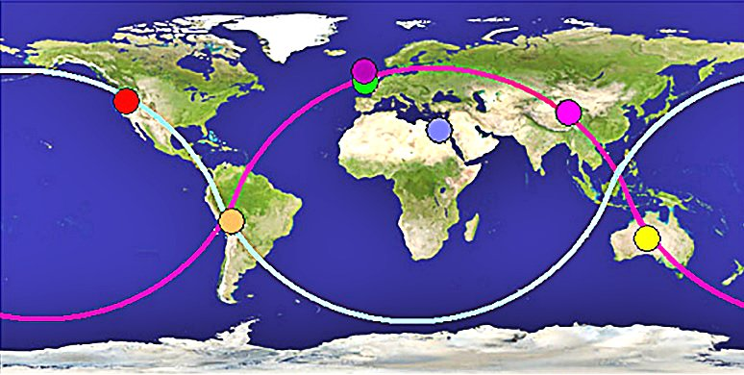



Motivation and summary I am a data analytics works on covid-19. one of my Clint would to see the CDC web site and WHO web sit the cases reported on daily reported cases around the global

Slide 3


Hypothesis and Null hypothesis
-Research Question:
Which country are more cases reported and, which country are less cases reported, Is US less reported in covid-19 and is covid-19 spread the global
-Hypothesis:
In the world a country has power full economic countries had highly numbers of covid-19 cases reported in the world
-Null Hypothesis:
There is no significantly deference b/n high populated and high economic country have reported high numbers of covid-19

Slide 4
filename = "time_series_covid19.csv"
filedata=pd.read_csv(filename)
filedata \Program FileffMongoDS.2\bin Fi
Province/State | Country/Region | Lat | Long | 1/22/20 | 1/23/20 | 1/24/20 | 1/25/20 | 1/26/20 | 1/27/20 | ... | 4/14/20 | 4/15/20 | 4/16/20 | 4/17/20 | 4/18/20 | 4/19/20 | 4/20/20 | 4/21/20 | 4/22/20 | 4/23/20
0 | NaN | Afghanistan | 33.000000 | 65.000000 | 0 | 0 | 0 | 0 | 0 | 0 | ... | 714 | 784 | 840 | 906 | 933 | 996 | 1026 | 1092 | 1176 | 1279
1 | NaN | Albania | 41.153300 | 20.168300 | 0 | 0 | 0 | 0 | 0 | 0 | ... | 475 | 494 | 518 | 539 | 548 | 562 | 584 | 609 | 634 | 663
2 | NaN | Algeria | 28.033900 | 1.659600 | 0 | 0 | 0 | 0 | 0 | 0 | ... | 2070 | 2160 | 2268 | 2418 | 2534 | 2629 | 2718 | 2811 | 2910 | 3007
3 | NaN | Andorra | 42.506300 | 1.521800 | 0 | 0 | 0 | 0 | 0 | 0 | ... | 659 | 673 | 673 | 696 | 704 | 713 | 717 | 717 | 723 | 723
4 | NaN | Angola | -11.202700 | 17.873900 | 0 | 0 | 0 | 0 | 0 | 0 | ... | 19 | 19 | 19 | 19 | 24 | 24 | 24 | 24 | 25 | 25
... | ... | ... | ... | ... | ... | ... | ... | ... | ... | ... | ... | ... | ... | ... | ... | ... | ... | ... | ... | ... | ...
259 | Saint Pierre and Miquelon | France | 46.885200 | -56.315900 | 0 | 0 | 0 | 0 | 0 | 0 | ... | 1 | 1 | 1 | 1 | 1 | 1 | 1 | 1 | 1 | 1
260 | NaN | South Sudan | 6.877000 | 31.307000 | 0 | 0 | 0 | 0 | 0 | 0 | ... | 4 | 4 | 4 | 4 | 4 | 4 | 4 | 4 | 4 | 5
261 | NaN | Western Sahara | 24.215500 | -12.885800 | 0 | 0 | 0 | 0 | 0 | 0 | ... | 6 | 6 | 6 | 6 | 6 | 6 | 6 | 6 | 6 | 6
262 | NaN | Sao Tome and Principe | 0.186360 | 6.613081 | 0 | 0 | 0 | 0 | 0 | 0 | ... | 4 | 4 | 4 | 4 | 4 | 4 | 4 | 4 | 4 | 4
263 | NaN | Yemen | 15.552727 | 48.516388 | 0 | 0 | 0 | 0 | 0 | 0 | ... | 1 | 1 | 1 | 1 | 1 | 1 | 1 | 1 | 1 | 1
264 rows × 97 columns

Slide 5
Province/State object country object Lat float64 Long float64 1/22/20 int64 ... 4/19/20 int64 4/20/20 int64 4/21/20 int64 4/22/20 int64 totalcases int64 Length: 97, dtype: object
Province/State object country object Lat float64 Long float64 1/22/20 int64 ... 4/19/20 int64 4/20/20 int64 4/21/20 int64 4/22/20 int64 totalcases int64 Length: 97, dtype: object
#df.rename(columns={"A": "a", "B": "c"})
filedata=filedata.rename(columns={ "Country/Region":"country","4/23/20":"totalcases"})
filedata.dtypes
Province/State object
country object
Lat float64
Long float64
1/22/20 int64
...
4/19/20 int64
4/20/20 int64
4/21/20 int64
4/22/20 int64
totalcases int64
Length: 97, dtype: object

Slide 6
filedata = filedata.loc[filedata["totalcases"]>7000]
filedata
Province/State country Lat Long 1/22/20 1/23/20 1/24/20 1/25/20 1/26/20 1/27/20 ... 4/14/20 4/15/20 4/16/20 4/17/20 4/18/20 4/19/20 4/20/20 4/21/20 4/22/20 totalcases
16 NaN Austria 47.5162 14.5501 0 0 0 0 0 0 ... 14226 14336 14476 14595 14671 14749 14795 14873 14925 15002
22 NaN Belarus 53.7098 27.9534 0 0 0 0 0 0 ... 3281 3728 4204 4779 4779 4779 6264 6723 7281 8022
23 NaN Belgium 50.8333 4.0000 0 0 0 0 0 0 ... 31119 33573 34809 36138 37183 38496 39983 40956 41889 42797
28 NaN Brazil -14.2350 -51.9253 0 0 0 0 0 0 ... 25262 28320 30425 33682 36658 38654 40743 43079 45757 50036
42 Ontario Canada 51.2538 -85.3232 0 0 0 0 1 1 ... 7953 8447 9840 10456 11013 11561 12063 12715 13718 14068
44 Quebec Canada 52.9399 -73.5491 0 0 0 0 0 0 ... 14248 14860 15857 16798 17521 17950 19319 20126 20965 21838
48 NaN Chile -35.6751 -71.5430 0 0 0 0 0 0 ... 7917 8273 8807 9252 9730 10088 10507 10832 11296 11812
62 Hubei China 30.9756 112.2707 444 444 549 761 1058 1423 ... 67803 67803 67803 68128 68128 68128 68128 68128 68128 68128
91 NaN Czechia 49.8175 15.4730 0 0 0 0 0 0 ... 6111 6216 6433 6549 6606 6746 6900 7033 7132 7187
94 NaN Denmark 56.2639 9.5018 0 0 0 0 0 0 ...

Slide 7
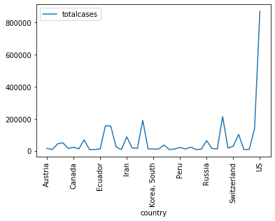
filedata.plot("country","totalcases")
plt.xticks(rotation=90)
array([-5., 0., 5., 10., 15., 20., 25., 30., 35., 40., 45.]), <a list of 11 Text xticklabel objects>)

Slide 8


Slide 9
Thank you

